Slide 1
Data Structures and Algorithms
Lecture 8: Priority Queue and Heapsort
（优先队列，堆排序）
Data Science
United International College

Slide 2
Outline
Trees (树) and Binary Heaps (二叉堆)
Priority Queue (优先队列)
  insert
  deleteMin
Heap sort (堆排序)

Slide 3
Motivating Example
3 jobs have been submitted to a printer in the order A, B, C.
Average waiting time with FIFO (First Input First Output):
(100+110+111) / 3 = 107 time units
Average waiting time with shortest-job-first:
(1+11+111) / 3 = 41 time units
Job A | 100 pages
Job B | 10 pages
Job C | 1 page
Queue
What Data
Structure?

Slide 4
Priority Queue (优先队列)
A queue capable of insert and deleteMin:

Slide 5
Priority Queue
Priority queue is a data structure which allows at least two operations
  insert
  deleteMin: delete Minimum
    finds, returns and removes the minimum elements in the priority queue
Applications: external sorting, greedy algorithms
Priority Queue
deleteMin
insert
Notes:
External sorting is a class of sorting algorithms that can handle massive amounts of data.
The sorting of relations which do not fit in the memory because their size is larger than the memory size. Such type of sorting is known as External Sorting.

Slide 6
Implementation
Linked List or Array?
  insert: O(1) or O(n)
  deleteMin: O(n)
Goal
  insert: O(log(n))
  deleteMin: O(log(n))
Too Slow

Slide 7

Implementation: Trees

Slide 8
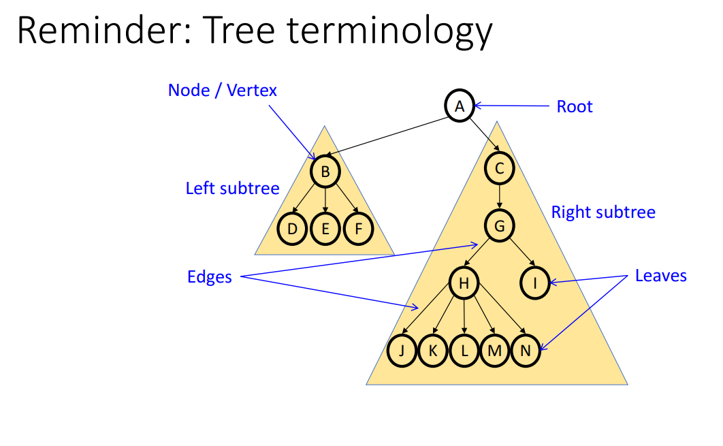

Slide 9
Background: Binary Trees (二叉树)
Has a root at the topmost level
Each node has zero, one or two children
A node that has no child is called a leaf
For a node x, we denote the left child, right child and the parent of x as left(x), right(x) and parent(x), respectively.
root
parent(x)
x
leaf
leaf
left(x)
right(x)
leaf

Slide 10
Tree Height (Depth)
The number of edges on the longest path (路径) from the root to a leaf
  height = depth = 4

Slide 11
Perfect Binary Trees
A perfect binary tree is the tree
  where a node can have 0 or 2 children and
  all leaves are at the same depth
height | # of nodes
0 | 1
1 | 3
2 | 7
3 | 15
d | 2^{d+1} - 1
Notes:
# of nodes is: (1+2^1+2^2+…+2^d) = 2^(d+1) -1 when the height of the tree is d

Slide 12
Property
A perfect binary tree with n nodes has height of O(log(n))
  Implication: If the number of node access within an algorithm is bounded by the tree height, then its complexity is O(log(n))!
Side notes
  The largest depth of a binary tree of n nodes is O(n)
  What is the shape of the tree?
Notes:
For the side notes: there are n-1 edges, and for each node (except the leaf) there is only one child.

Slide 13
Given the number of nodes (data size):
Balanced Tree Structure
Small Tree Height
Efficient Traversal Algorithm

Slide 14
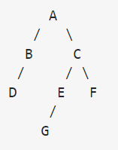
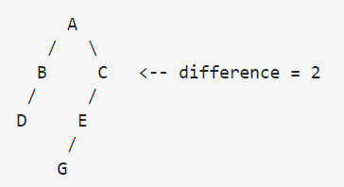
A tree is balanced if and only if:
The left and right subtrees' heights differ by at most one, AND
The left subtree is balanced, AND
The right subtree is balanced
The tree in the left is balanced, while the right one is not balanced.

Slide 15
Binary heaps (二叉堆)
It is always wise to keep a tree balanced.
Not all node sets, however, can form a perfect tree. Hence, we propose

Slide 16
Binary Heap
Heaps are “almost perfect binary trees”
  All levels are full except possibly the lowest level
  If the lowest level is not full, then nodes must be packed to the left
No “hole” from the first node to the last
Notes:
For the binary tree, “full” means that a node should have its sibling.

Slide 17
Property
Given a binary heap of node number n and height h
  n is within [2^{h}, 2^{h+1}-1]
  The height h=O(log(n))
  The structure is so regular, it can be represented in an array and no links are necessary !!!
Notes:
For the binary heap, the number of nodes until height h-1 is: 1+2^1+…+2^(h-1) = 2^h -1.
As at least one node exists at height h, so n is between [2^h, 2^(h+1) - 1]

Slide 18
Array Implementation of Binary Heaps
Concept: A tree
Given a node x at position i
left(x) is at position 2i+1
right(x) is at position 2i+2
parent(x) is at position (i-1)/2
Side Nodes
It’s not wise to store normal binary trees in arrays, coz it may generate many holes
Implementation: An Array
A | B | C | D | E | F | G | H | I | J
0 | 1 | 2 | 3 | 4 | 5 | 6 | 7 | 8 | 9
A
B
C
D
E
F
G
H
I
J

Slide 19
Implementation Flow
Use an Array to …
Implement a Binary Heap to…
Implement a Priority Queue

Slide 20
A MINIMUM priority queue has
Binary Heap Structure
Heap Order Property
  The value at each node is less than or equal to the values at both its descendants (子孙)
  The smallest node is always on the top
Use of binary heap is so common for priority queue implementations, thus the word heap is usually assumed to be the implementation of the data structure

Slide 21
A minimum Heap
Not Heaps (WHY?)
1
2
5
1
4
3
6
2
5
1
4
3
6
3
5
4
2
6

Slide 22
Heap Properties
Heap supports the following operations efficiently
  Insert in O(logN) time
  Locate the current minimum in O(1) time
  Delete the current minimum in O(log N) time
Note: After each insert/delete operation, the heap must remain a heap

Slide 23
Insertion
Algorithm
  Add the new element to the next available position at the lowest level
  Restore the min-heap property if violated
    General strategy is percolate up (上浮): if the parent of the element is larger than the element, then interchange the parent and child.
1
1
1
3
7
3
7
3
5
swap
4
6
9
4
6
9
5
4
6
9
7
Insert 5

Slide 24
An Implementation Trick
Implementation of percolation in the insert routine
  by performing repeated swaps: 3 assignment statements for a swap.
  3d assignments if an element is percolated up d levels
  An enhancement: Hole digging with d+1 assignments
Insert 1…
2
2
5
3
5
1
3
6
1
7
4
7
6
4
7
Dig a hole
Compare 1 with 7
Compare 1 with 5
9
8
9
8
7

Slide 25

Insertion Complexity
2
1
1
3
2
3
6
5
4
5
6
5
4
5
Compare 1 with 2
9
8
7
9
8
7
Time Complexity = O(height) = O(logN)

Slide 26
Insertion Pseudo Code
INSERT(A, int &size, x)
1. IF ISFULL(A)
2. return False
3. // percolate up
4. hole = size++;
5. WHILE hole>0 AND x<A[(hole-1)/2]{
6. A[hole] = A[(hole-1)/2];
hole = (hole-1)/2; }
A[hole] = x;
return True
Notes:
Get the size of array using pointer: _msize(A) / sizeof(int))

Slide 27
deleteMin
Same Strategy
  First, maintain binary heap structure
    Replace the root with the value of the last node
  Then, maintain heap order property
    Percolate down (下浮)

Slide 28
deleteMin Example
1
7
2
2
3
2
3
7
3
6
5
4
5
6
5
4
5
6
5
4
5
9
8
7
9
8
9
8
deleteMin() called
replace the root
swap with the smallest in the family

Slide 29
deleteMin Example
2
5
3
6
7
4
5
9
8
swap with the smallest in the family

Slide 30
Hole trick
The “dig a hole” trick can be applied on delete, too!

Slide 31
deleteMin Pseudo Code
DETELE-MIN(A, int &size)
1. IF ISEMPTY(A)
2. return False
3. min = A[0], hole = 0, x=A[--size]
4. // percolate down
4. WHILE A[hole] has children
5. sid = index of A[hole]’s smaller child
6. IF x<=A[sid]
BREAK
A[hole] = A[sid]
hole = sid
A[hole] = x
return min
Notes:
How to

Slide 32
Heapsort
A sorting algorithm based on heaps

Slide 33
Heapsort
Build a binary heap of n elements
    the minimum element is at the top of the heap
Perform n DeleteMin operations
    the elements are extracted in sorted order
Record these elements in a second array and then copy the array back
O(nlog(n))
O(nlog(n))
O(n) storage

Slide 34
Can we do better?

Slide 35
Heapsort: No Extra Storage
Observation: after each deleteMin, the size of heap shrinks by 1
  We can use the last cell just freed up to store the element that was just deleted
  after the last deleteMin, the array will contain the elements in decreasing order
Further observation:
  To sort the elements in decreasing order, use a minimum heap
  To sort the elements in increasing order, use a maximum heap
    Maximum Heap: the parent has a larger element than the child

Slide 36
Example: Maximum Heap Build-up
H
K
K
H
H
G
Heap
Zone
Data
Zone
Heap
Zone
Data
Zone
Heap
Zone
Data
Zone
H | K | G | A | E | C
0 | 1 | 2 | 3 | 4 | 5
K | H | G | A | E | C
0 | 1 | 2 | 3 | 4 | 5
K | H | G | A | E | C
0 | 1 | 2 | 3 | 4 | 5

Slide 37
Example: Maximum Heap Build-up
K
K
K
H
G
H
G
H
G
A
A
E
A
E
C
K | H | G | A | E | C
0 | 1 | 2 | 3 | 4 | 5
K | H | G | A | E | C
0 | 1 | 2 | 3 | 4 | 5
K | H | G | A | E | C
0 | 1 | 2 | 3 | 4 | 5

Slide 38
Example: deteleMax
H
G
E
E
G
E
C
A
C
A
C
A
H | E | G | A | C | K
0 | 1 | 2 | 3 | 4 | 5
G | E | C | A | H | K
0 | 1 | 2 | 3 | 4 | 5
E | A | C | G | H | K
0 | 1 | 2 | 3 | 4 | 5

Slide 39
Example: deteleMax
C
A
A
C | A | E | G | H | K
0 | 1 | 2 | 3 | 4 | 5
A | C | E | G | H | K
0 | 1 | 2 | 3 | 4 | 5
A | C | E | G | H | K
0 | 1 | 2 | 3 | 4 | 5

Slide 40
Heapsort Pseudo Code
HEAPSORT(A, size)
1. FOR i=0 TO size-1
2. // maximum heap is used here
3. INSERT(A, i, A[i])
4. FOR i=size-1 TO 0
5. A[i] = DELETE-MAX(A, i+1)

Slide 41
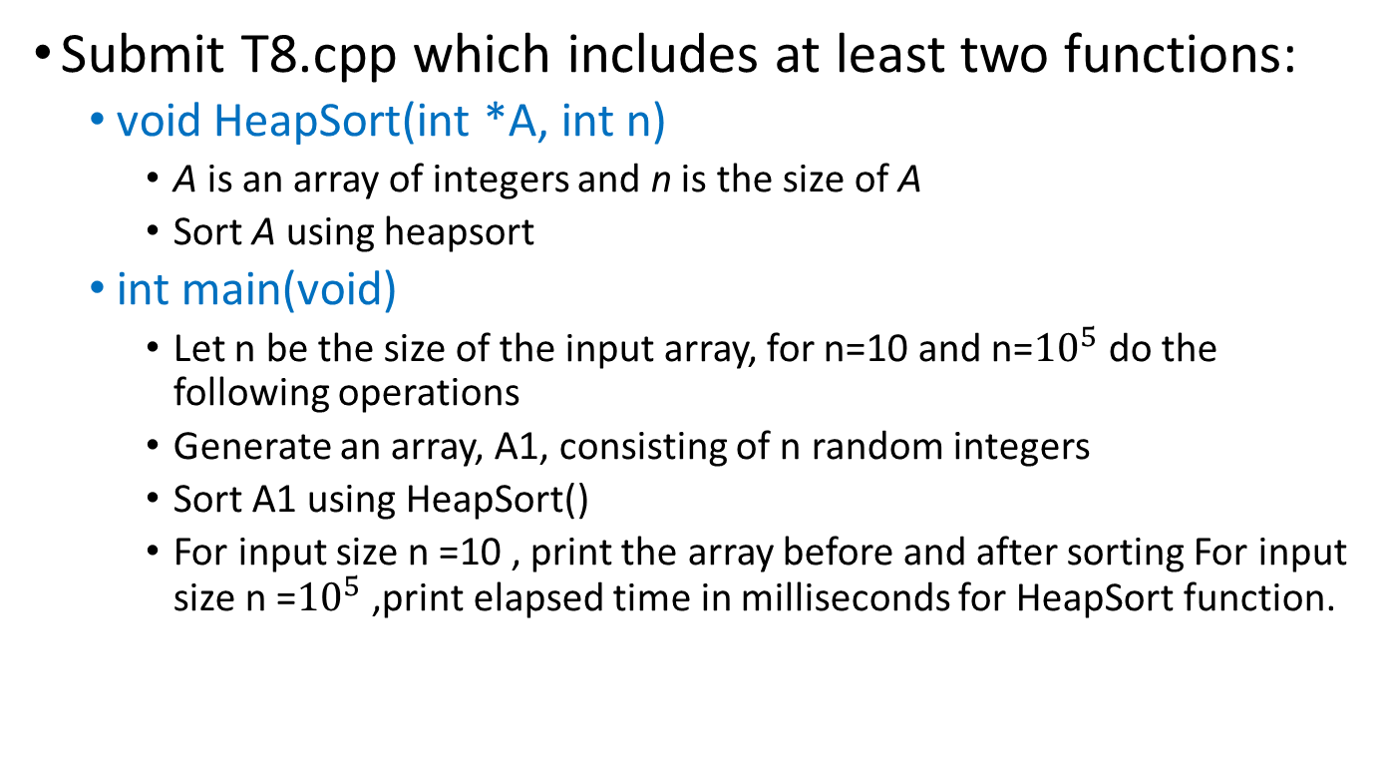
Task
Submit T8.cpp which includes at least two functions:
  void HeapSort(int *A, int n)
    A is an array of integers and n is the size of A
    Sort A using heapsort
  int main(void)
    Let n be the size of the input array, for n=10 and n=${10}^{5}$ do the following operations
    Generate an array, A1, consisting of n random integers
    Sort A1 using HeapSort()
    For input size n =10 , print the array before and after sorting For input size n =${10}^{5}$ ,print elapsed time in milliseconds for HeapSort function.

